Slide 1

Version Control Using git and GitHub
The why, what and how
Derek Smith

Slide 2
What - Version Control
Ability to revert a file (e.g., .docx, .R, .sas, etc.) to any previous state
git version control software initially created for web and software development
Other types of version control software:
Mercurial
SVK
Fossil
Subversion
Reproducible research has increased its use in the scientific community
Beneficial for personal and collaborative work
Simultaneously work on the same document or code
Each version update is accompanied with a “commit” message. This eliminates the need for saving documents such as XXXXXX_2017_09_11_DS…

Slide 3
Jargon
Repository (“repo”) - A project specific folder to be version controlled. Subfolders can be contained within the main project folder.
Staging environment - Where modified files and new files can be added.
Add
Set-up a file in the staging environment to be committed
Commit
Create a snapshot of the repository at a current state.
A commit message can be added to provide details on what changes are contained in the files.
Push
Making local version changes using git that were a part of the commit.
Multiple commits can be pushed at once.
Pull
Check the remote repository for any changes that may have been made and have your local copy updated.
Important for collaborative work. Not as important for individual work unless working on multiple machines.

Slide 4
Jargon cont.
Master - The primary version.
Branch - A separate version from the master that is specific to you. Used for testing out new functionally without changing the master (e.g. stable) version. More applicable for software development and collaborative work.
Reverting - Going back to a previous version based on a specific commit.
Clone - Copying an existing repository and all of its existing version information.
A glossary of other git terms

Slide 5
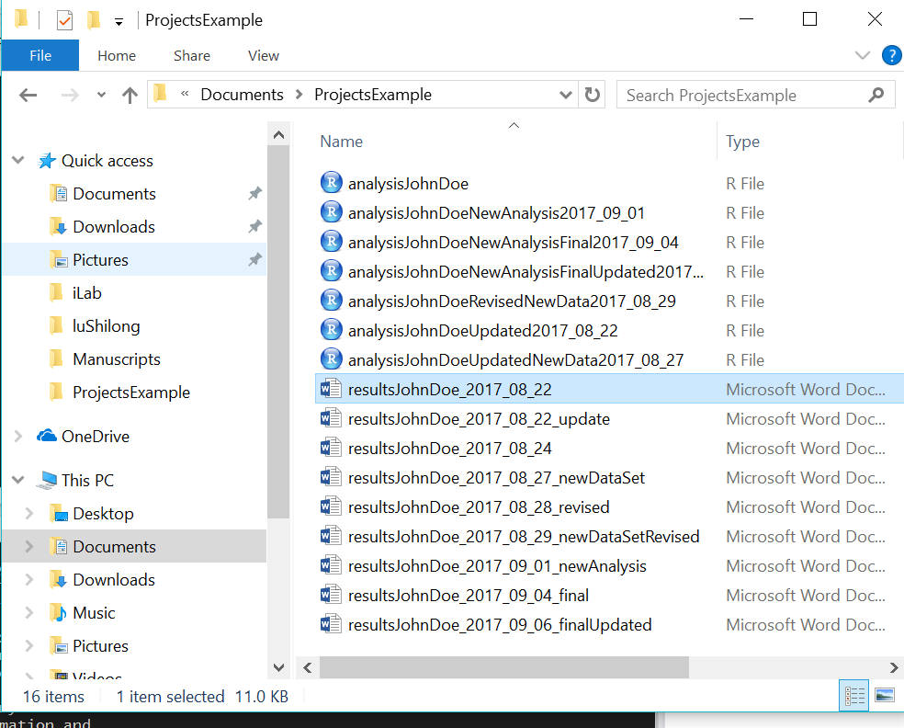
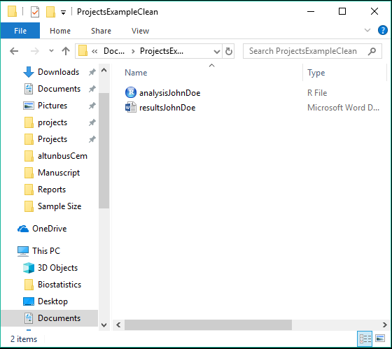
Reproducible Research
Before git
After git

Slide 6
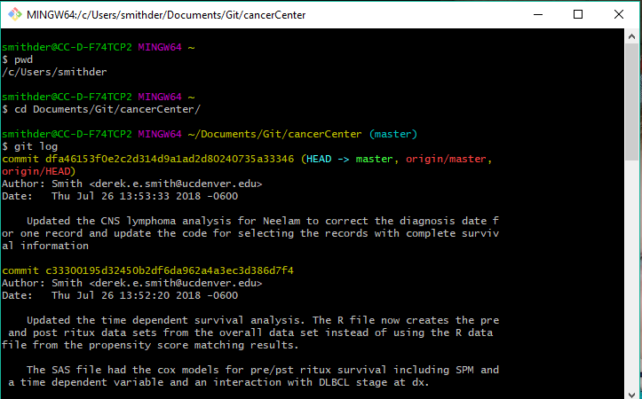
Reproducible Research
Each version saved with a message of changes
Commit
message

Slide 7




git vs. GitHub
GitHub – Website to host Git projects
Working Directory
git – Local Version Control

Slide 8

Demystifying git
How does it work?
Set-up a git repository in the directory (e.g., project folder) of interest
git monitors any changes in that directory and any added subdirectories
A SHA-1 (Secure Hash Algorithm 1) 40 digit hexadecimal number is created
A new SHA-1 key is created each time the size of a file changes in the git repo
Information for all saved version are compressed into a database in the git directory
A given SHA-1 key can be used to revert the repo back to its state at that point in time

Slide 9
Demystifying Git
SHA-1 key

Slide 10

GitHub
GitHub
Collaboration and or backup git projects
Currently the largest host of source code in the world
Over 28 million users and 57 million repositories
Features
Documentation (e.g., README and markdown files)
Issue tracking
Wikis
History of changes with comments
Metrics for use (contributors, changes, etc.)
Email notifications

Slide 11
Workflow
Remote Repository
Pull
Working Directory
Add
Staging Env
Commit
Push
Local Repository

Slide 12
Workflow
Initial Repo Creation
Create Repo from Existing Directory
Create repo on GitHub
Clone repo on local machine
Add stuff to the repo
Commit the new or updated files (stores changes locally)
Push to information to GitHub
Create repo on GitHub
Clone repo on local machine
Copy the existing files to the new folder
Commit the new or updated files (stores changes locally)
Push to information to GitHub

Slide 13
Collaboration
Manage
Documents
Code
Collaborative
Same project
Share and modify routine code
Simultaneously work on code or documents
Share common analysis files
Data Manipulation
Routine Procedure

Slide 14
Best Practices
Pull
Before making any changes to files, pull to obtain the most recent version.
Commit
Commit often.
Commit message should be detailed to provide others a brief overview of the changes.
ReadMe
Include a ReadMe.txt file in the initial repo folder detailing its purpose.
Include ReadMe.txt files in each subfolder that details its contents.
.gitignore
Use a ‘.gitignore’ file to indicate any files you don’t want to track.

Slide 15
How - Working with Git and GitHub
Common Interfaces:
Command Line (terminal, command prompt, or powershell)
Rstudio
GitKraken
GitHub Desktop
Sourcetree

Slide 16
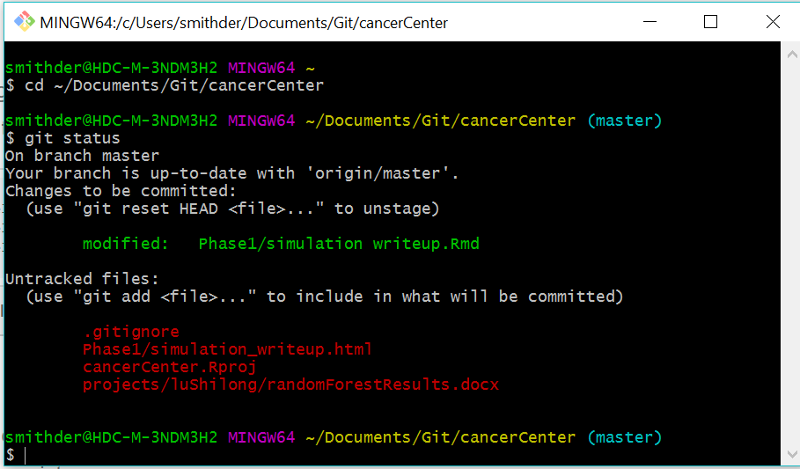
How - Terminal
Example of standard commands:
git status
git add
git commit –m “….”
git pull
git push
git branch
Good Cheat Sheets for common commands 1, 2

Slide 17
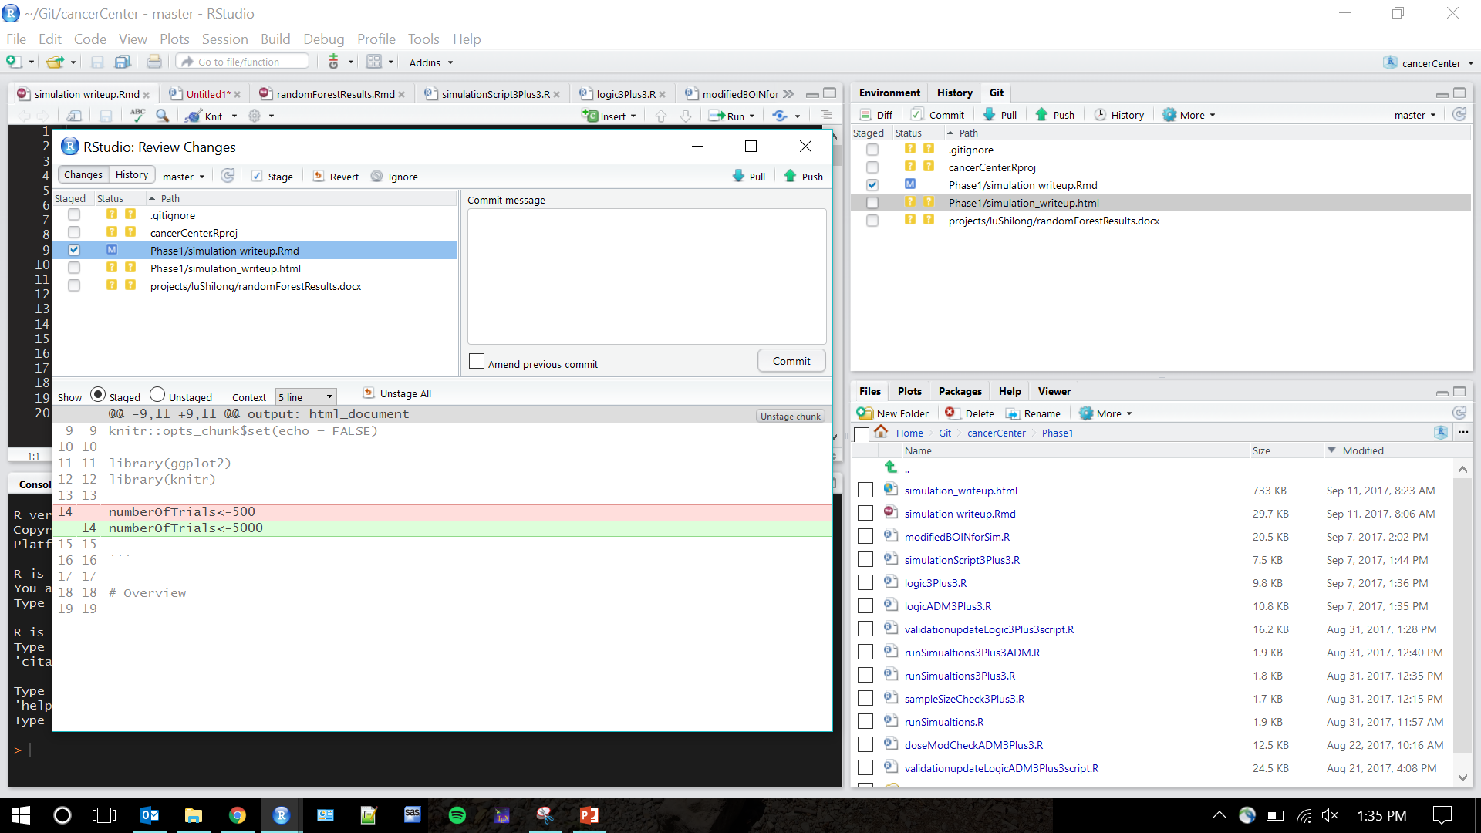

How - RStudio

Slide 18

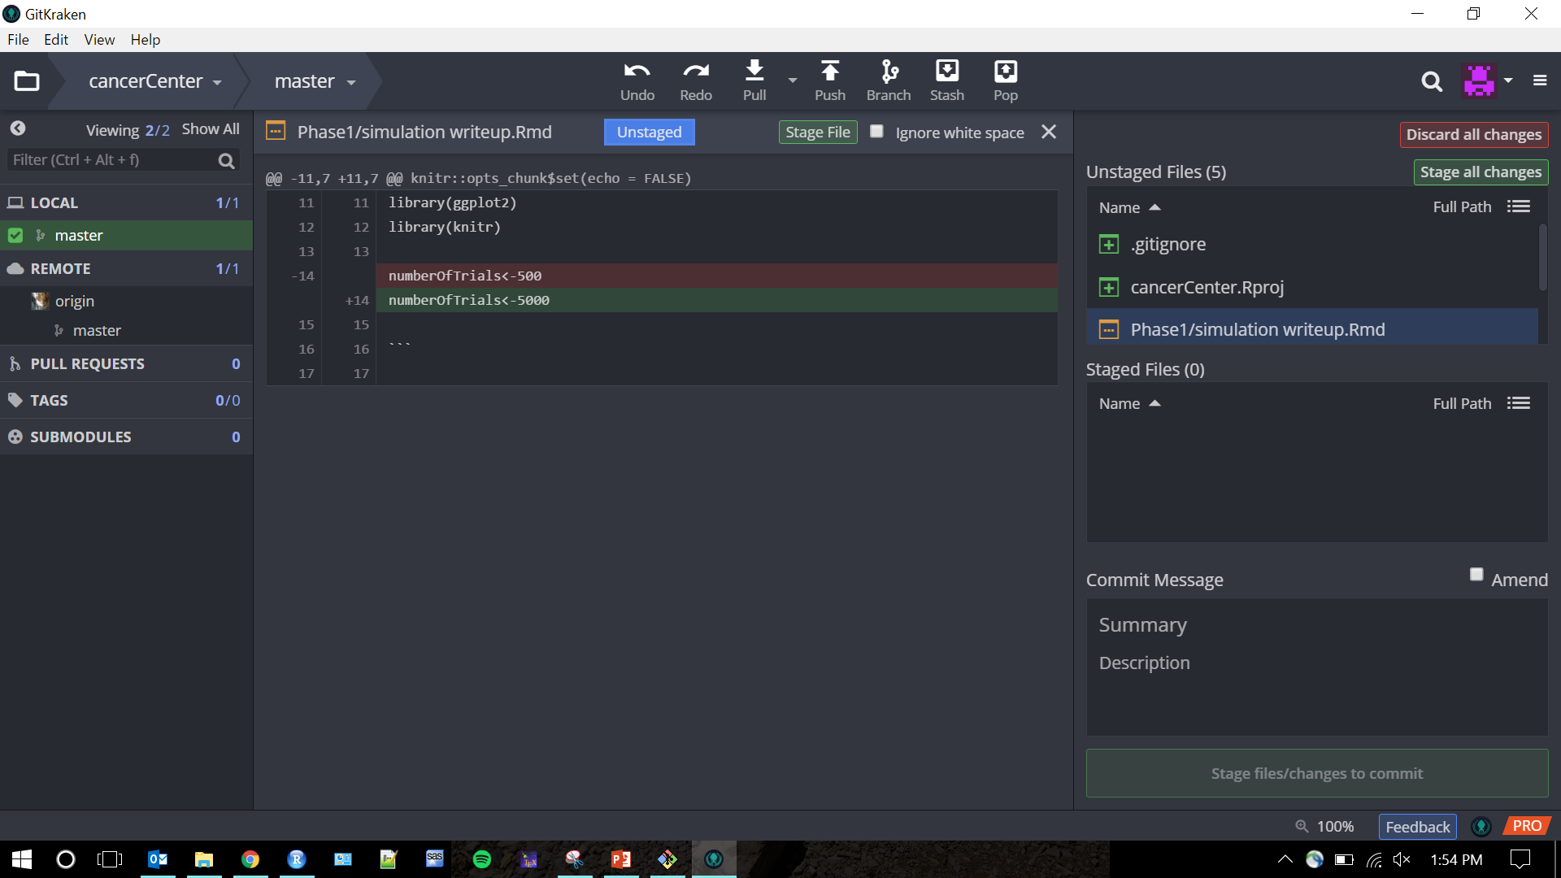
How – GitKraken

Slide 19
Group Workflow
Remote Repository
Pull
Working Directory
Commit
Local Repository
Push

Slide 20
Group Workflow – Working from master
Master Commit/Merge
User 1
User 3
Master
Pull Request
User 2
Time

Slide 21
Group Workflow - Branches
Branch Commit
User 1
Master Commit/Merge
Branch
Master
User 2
Pull Request
User 3
Time

Slide 22
Steps
Install git
https://git-scm.com/
Create a GitHub account
https://github.com/
Create a “local” git repository
Push the repository to your GitHub account

Slide 23
GitHub Alternatives
GitHub
Educational discount (currently free with .edu email address)
$7/month for a personal account
Team and user permissions
$25/month for first 5 users and $9 per user afterwards
GitLab
Individual free
Team $4/month per user
BitBucket
Individual Free
Teams ≤ 5 users free
SourceForge
Free but no private repository option

Slide 24

Note on Datasets
Do not push data to the web based git platforms (e.g., GitHub)
This includes .Rdata and .sas7bdat files
Private accounts do not protect data
Storage limits (1 GB per repository)
Can include file extensions to .gitignore
Source: The NewScientist

Slide 25
Getting Started
Create a “local” git repository
Push the repository to your GitHub account
Download
Git
Choose your interface
GitKraken
R Studio
Terminal
Create a GitHub account
https://github.com/

Slide 26
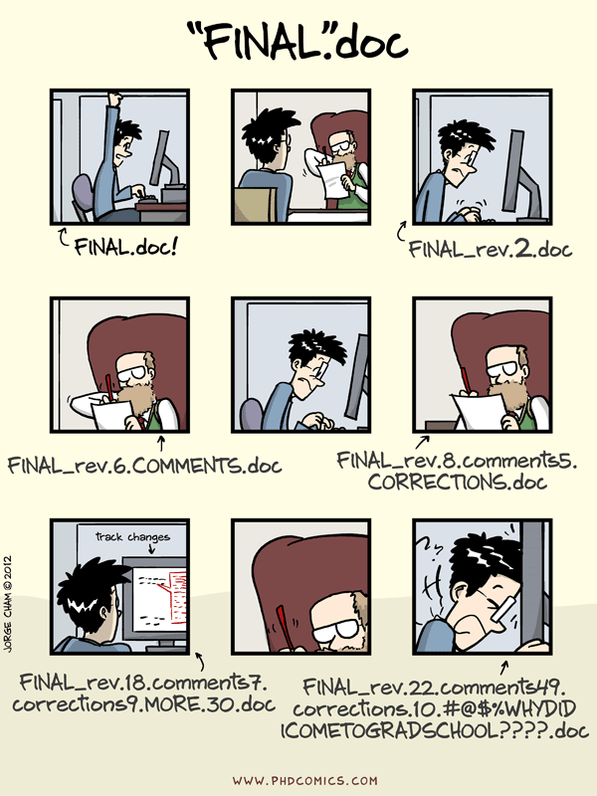
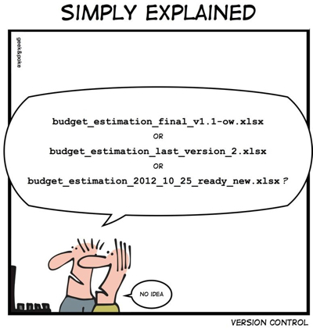
Questions?

